Slide 1

Is small the new big?
Maria Sgourou – Translator/Digital Marketeer mariasgourou.com
Vilelmini Sosoni – Lecturer/Translator
Ionian University
22-23 February 2018
Athens, Greece

Slide 2
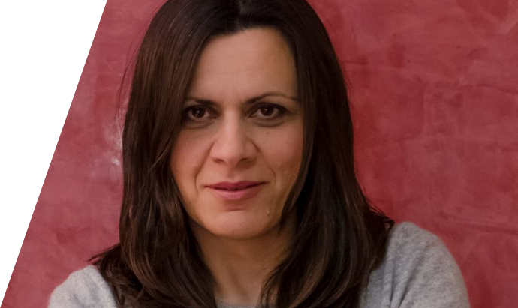
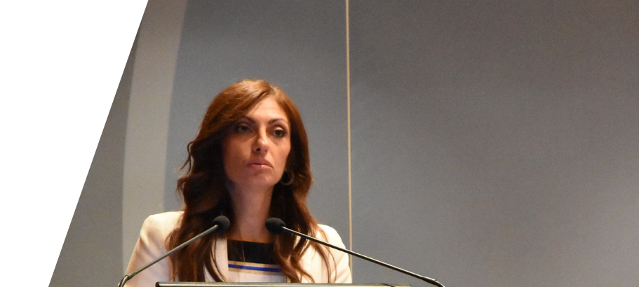
Maria Sgourou Vilelmini Sosoni
Notes:
This is us in order of appearance!
Maria Sgourou Translator – passionate about innovation, new ideas and trends – usually my head in the clouds thinking everything is possible
- I am the good guy
And
Vilelmini Sosoni Lecturer at the Ionian University massive experience in everything, she needs facts to connect the dots
– she is the bad guy

Slide 3

You will find our stories here

Slide 4
Sharing is caring!
#eliatogether
Notes:
If you want to share your thoughts online

Slide 5

Once upon a time
Notes:
Once upon a time
More than ten years ago
As I remember it
it was all about website translation and quotes for content translation, it didn’t matter who wrote that content, how it was written, who it was addressed to, hat was the reason or the purpose. But that was the beginning and it was fine.
In fact, if you remember at that time websites were for most part identical.
They all had the same menu, about, mission, statement [it was different back then], left side menus and so on…
Visiting a website it was a different experience back then than it is now.
Later on..
The requests were not only for translation but also for content creation and not just for websites, but also for other marketing material. I had to create the content first and arrange for the translation afterwards.
There was a shift in the clients’ needs, they realized that the content was important and that it should be taken seriously.
Nowadays …
I see another shift in what the clients need. I have started getting requests for content for social media post and social media campaigns, and when I talk about social media for me is Facebook because in this I am specializing.
And together with this content, clients really appreciate a good piece of advice on how to use that content and even ask to do it for them.
When I started thinking about these milestones I begun to wander

Slide 6

Later on …

Slide 7
Top Priorities
Content
Translation
Message

Slide 8

The big picture

Slide 9
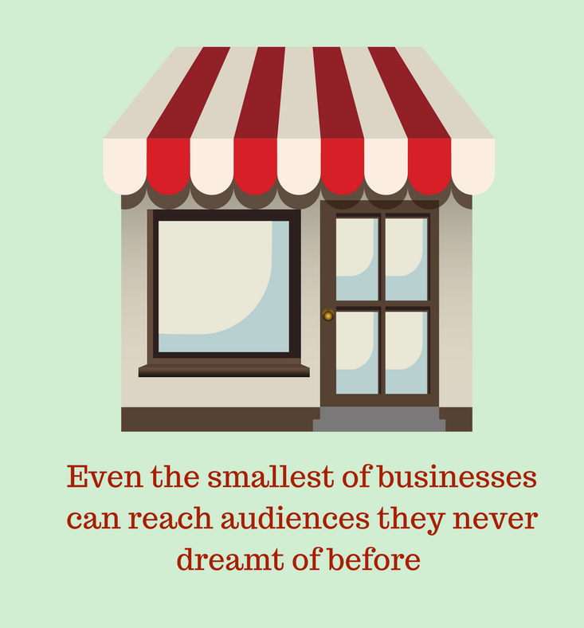
The big picture
Digital economy has democratized marketing
Marketing tools are easy to use and cost-effective
Messages cross local borders and reach wider audiences
Notes:
Lets talk about trends, the biggest of trends, the digital economy.
The digital economy as we are experiencing it has made marketing accessible to everyone, it has democratized marketing.
The promotion of a business with digital tools, online is easy to implement, less expensive than any other means, and much-much more effective.
The smallest of business, now more than ever, really stand a chance to grow beyond the local borders, if they realize the potential of the digital means for their business, if they realized that that all they need is a custom marketing plan and a well-trained professional to implement it.
And by marketing plan we don’t mean massive amounts of money or hordes of marketers.

Slide 10

Let's keep it simple with an example
Notes:
To keep it simple here is an example:
I am a business owner and I want to expand to reach clients to let’s say, Italy.
Having a website and a Facebook page and having decided to spend let’s say 10 euros per day I can reach a potential audience of 20.000.000, and this is a fact, plain and simple.
Don’t you agree?

Slide 11

What do small businesses need?
A message to get across to people
beyond local borders
Notes:
A marketing plan for small businesses is all about a message, a marketing plan should be build around a message and messages are nothing but well-arranged words that make an impact.
Well-arranged words that need to be properly, translated, transcreated, localized to reach their target, to reach their audience.

Slide 12

Who is going to deliver their message
Notes:
Now, when talking about delivering messages, beyond borders and across cultures, who do you think of?
I’d have somebody in mind, I bet you all have somebody in mind, a translator maybe?
It is one of the cases where machine translation does not deliver given the creative nature of the task at hand. The creativity and cultural intermediation skills of the translator are sine qua non.

Slide 13

You, my gorgeous colleagues

Slide 14
Key questions
Do SMEs need digital content translation/localization?
Have translators identified the potential of this growing area?
Do LSPs provide digital content/digital marketing services?

Slide 15

Our surveys
Three questionnaires: one for SMEs, one for LSPs & one for freelance translators
Included mainly closed questions for ease of response and some open-ended questions to allow respondents to express their views more freely
November-December 2017
Greece
Circulated through social media & mailing lists
104 SMEs
20 LSPs
291 freelance translators
Notes:
In order to answer those questions we sought to gather empirical data by carrying out surveys in the form of questionnaires. As pointed out already, we wanted to establish whether SMEs need digital content translation and we also wanted to know whether freelance translators and LSPs offer multilingual digital copyanslation services.
We thus designed three questionnaires: one for SMEs, one for LSPs, one for freelance translators
We included mainly closed questions for ease of response and some open-ended questions to allow respondents to express their views more freely
We circulated them from November through December 2017 in Greece through social media & mailing lists
We received answers from 104 LSPs, 20 LSPs and 291 freelance translators.

Slide 16
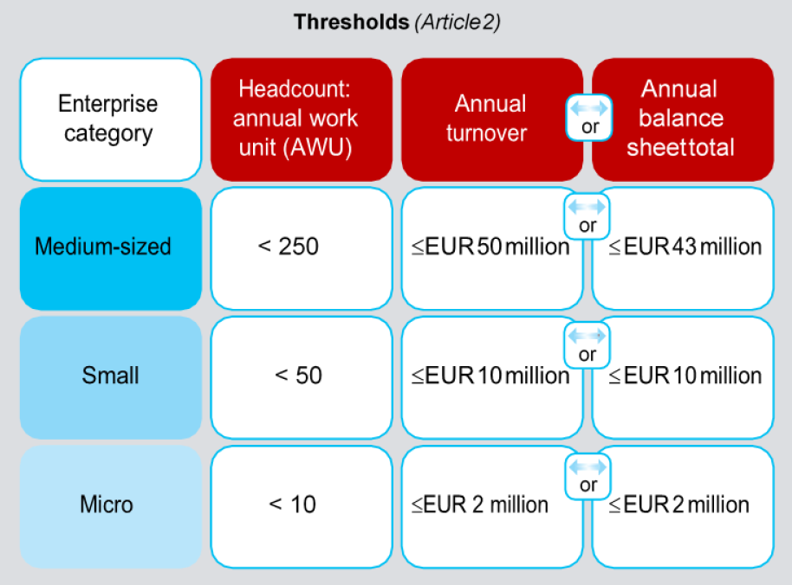
What is an SME?
SMEs are the engine of the European economy
"The category of micro, small and medium-sized enterprises (SMEs) is made up of enterprises which employ fewer than 250 persons and which have an annual turnover not exceeding 50 million euro, and/or an annual balance sheet total not exceeding 43 million euro" (Article 2 of the Annex of Recommendation 2003/361/EC).
Notes:
The definition of SME varies from country to country. In the present study, we have adopted the definition provided by the EU. According to the European Commission's Recommendation 361 of 2003, "The category of micro, small and medium-sized enterprises (SMEs) is made up of enterprises which employ fewer than 250 persons and which have an annual turnover not exceeding 50 million euro, and/or an annual balance sheet total not exceeding 43 million euro." In the table on the right, we can see that there are 3 types of SMEs, micro enterprises, small enterprises and medium sized enterprises. The classification depends on the number of employees they have and on their annual turnover. 1 employee full time/year = 1 AWU. The comanies that answered the questionnaire were either micro enterprises or small enterprises.

Slide 17
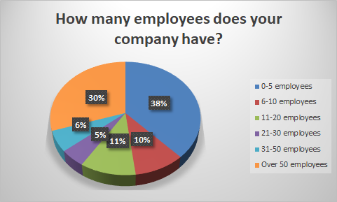
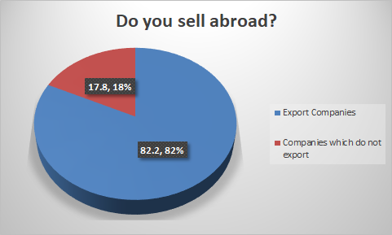
Some insights into SMEs (1)

Slide 18
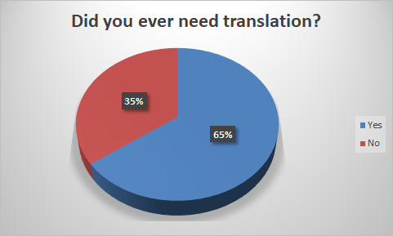
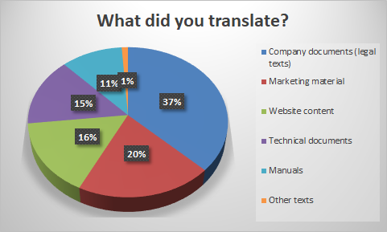
Some insights into SMEs (2)

Slide 19
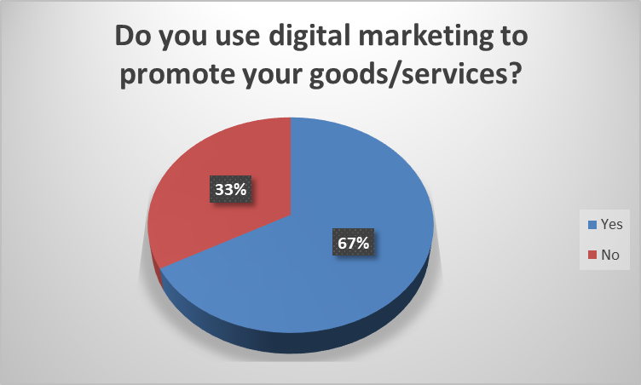
Some insights into SMEs (3)

Slide 20
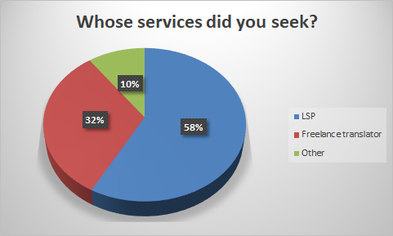
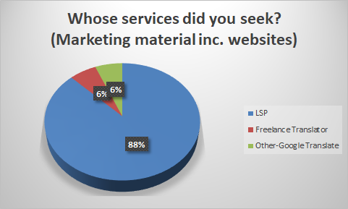
Some insights into SMEs (4)
Notes:
The findings are interesting. In their vast majority those SMEs who required the translation of marketing material, inc. websites, turned to LSPs. Only 6% turned to freelance translaors and interesting 6% used Google translate for the translation of their marFrom those who said Other, they all sought help of administrative employees. Two used google translate to localize the content of their websites!

Slide 21
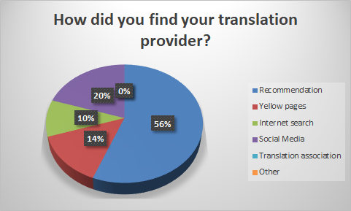
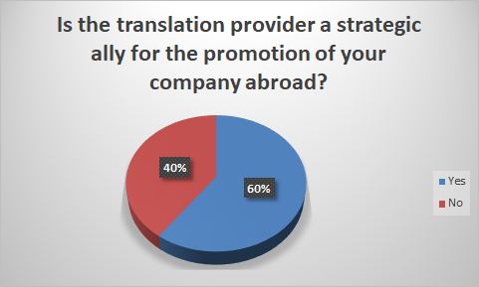
Some insights into SMEs (5)
Notes:
Word-of-mouth is important in a small country like Greece. Companies rely on recommendations primarily on recommendations and secondly on the Internet and social media. The most important finding is that 60% of the companies believe that translation providers are strategic allies for the promotion of their companies abroad.

Slide 22
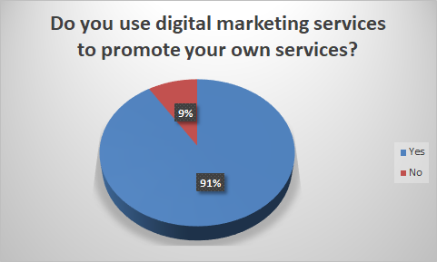
Digital marketing and LSPs (1)
Notes:
Let's move now to our findings regarding the LSPs. First we wanted to establish whether they themselves use digital marketing to promote their services. Interestingly, 91% of them do!

Slide 23
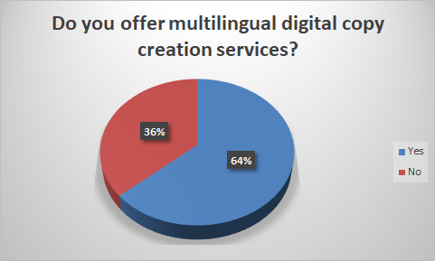
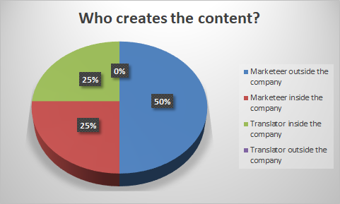
Digital marketing and LSPs (2)

Slide 24
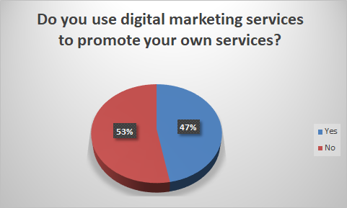
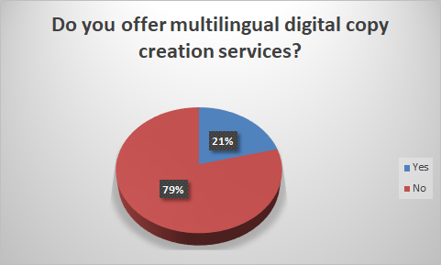
Digital marketing and Translators (1)
Notes:
The findings

Slide 25
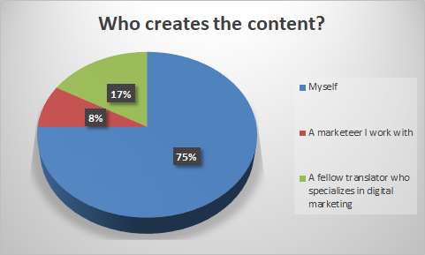
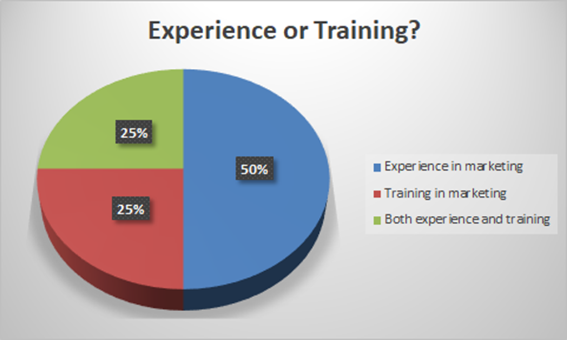
Digital marketing and Translators (2)
Notes:
The findings

Slide 26

A new trend
Multilingual digital content creation is becoming mainstream
A new job profile emerges at the intersection of marketing and translation
LSPs appear to have identified the opportunity, but do not always assign the job to translators
Translators are lagging behind

Slide 27
Pros and cons
Pros
New service for SMEs which increases visibility and their global appeal
Cons
SMEs need guidance and closer cooperation with translator professionals
New skills and adaptability
Additional training required
New specialization, less competition for LSPs and translators
Emerging job profile=new opportunities
Updated mindset required
Creative nature of work not threatened by MT
Translators have to prove themselves as multilingual digital copy creation experts
Notes:
Pros
For LSPs and translators, digital marketing constitutes a new specialization so there is less competition and more opportunities
For SMEs, digital marketing is a new type of service which will provide them and their product(s) visibility and new target groups abroad. There is potential growth. A Eurobarometer survey found that 45 percent of online users across the European Union only visit websites in their own languages. A global survey by Common Sense Advisory, meanwhile, found that 75 percent of consumers preferred to buy products in their native language. More than half (55 percent) would buy only from websites where information was presented in their language.
Cons
For LSPs and translators, additional training is required which is not always and readily available. New skills and adaptability.
SMEs can only gain from multilingual digital marketing, but they need guidance and close cooperation with skilled translation professionals. This can be challenging as they need to update their mindset, adopt a more global view for their products and services and trust translation. In turn, they ned additional training to gain specialisation in the area of digital marketing, but they also have to prove themselves as experts in multilingual digital copy creation.

Slide 28

How to...
LSPs and translators should work together to respond to this trend
Specialize in digital marketing
Make their services visible
Train their clients on the importance of digital marketing and their expertise as multilingual digital copy creators
Training institutions need to:
Take stock., adapt and offer new modules (e.g. transcreation, digital marketing)
Offer webinars, seminars and short courses
Collaborate with LSPs to optimally deliver this training
Notes:
So what’s the best way to respond to ths trend? LSPs and translators need to work together. Update their skills: specialise in digital marketing and develop their transcreation skills. Make these services visible. They also need to train their clients, highlight the importance of the message and the tone and the consistency in its delivery which requries continuous collaboration with the translation professional.
Training institutions need to take stock, adapt and include new modules in their training programmes, but also have offer webinars, seminars and short courses for professionals. Given the interdisciplinarity of this area and the scarcity of trainers, a collaboration with LSPs will lead to optimal results. Not everyone can have Tess Whitty.

Slide 29

Spread the word!
We intend to continue our research, so if you wish to reply to our surveys, receive the results or contribute in any other way or if you think they might be of benefit to you, your company or a colleague, feel free to spread the word or get in touch with us!
http://mariasgourou.com/ m.sgourou@hotmail.com
https://www.linkedin.com/in/vilelmini-sosoni-74000910/ Vilelmini@hotmail.com
Notes:
What we did is scratch the surface of this fascinating topic, so we intend to continue our research. If you wish to reply to our surveys, receive the results or contribute in any other way or if you think they might be of benefit to you, your agency or a colleague, feel free to spread the word or get in touch with us! You know where you can find us!

Slide 30
Thank you!

